Slide 1

Logistic Regression
Anushree s

Slide 2
Logistic Regression
Produces results in a binary format
Used to predict the outcome of a categorical dependent variable
The outcome should be discrete/ categorical
Ex:- 0 or 1, Yes or No, True or False, High or Low

Slide 3
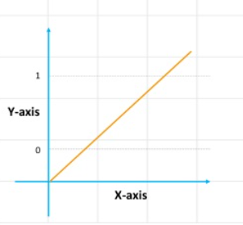
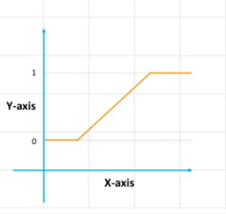
Drawback of Linear Regression
It is not suitable for classification problem
It is unbounded
Since our value of Y will be between 0 and 1, the linear line has to be clipped at 0 and 1
Resulting curve cannot be formulated into a single formula

Slide 4
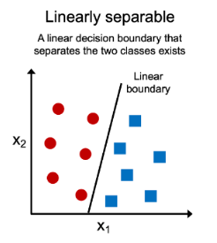
Requirement
Data should be linearly separable

Slide 5
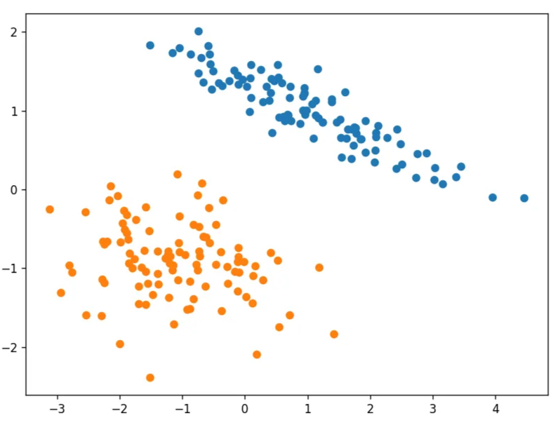
Perceptron Trick
Observation:
Linearly Separable
Equation of line:
Ax + By + C = 0
Objective:
To find the best values of A , B , & C

Slide 6
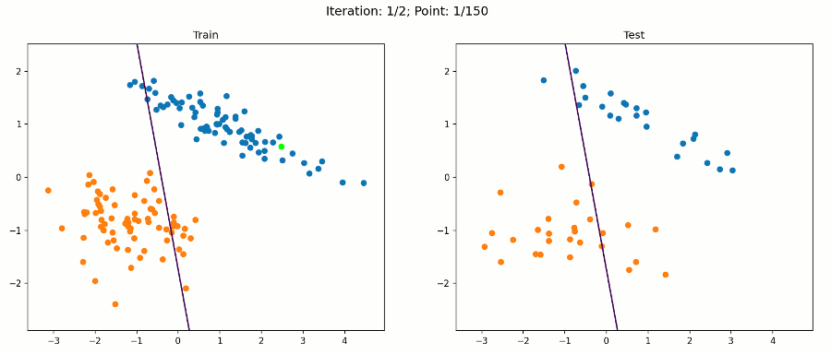
Algorithm
for i in range(epochs):
select a random point(i)
W_{n} = W₀ + ɳ(Y_{i} – Y_hat).X_{i}

Slide 7
Example
Y_{i} | Y_hat | Y_{i} – Y_hat | W_{n}
1 | 1 | 0 | W_{n =} W₀
0 | 0 | 0 | W_{n =} W₀
1 | 0 | 1 | W_{n} = W₀ + ɳ.X_{i}
0 | 1 | -1 | W_{n} = W₀ - ɳ.X_{i}

Slide 8
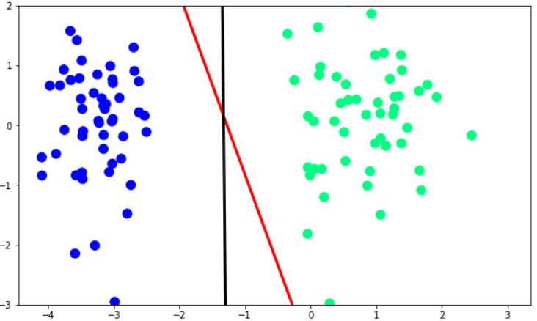
Comparison with the Logistic Regression

Slide 9
Limitation
Only modifies the misclassified points
Runs only till all the points are correctly classified
Uses the step function

Slide 10
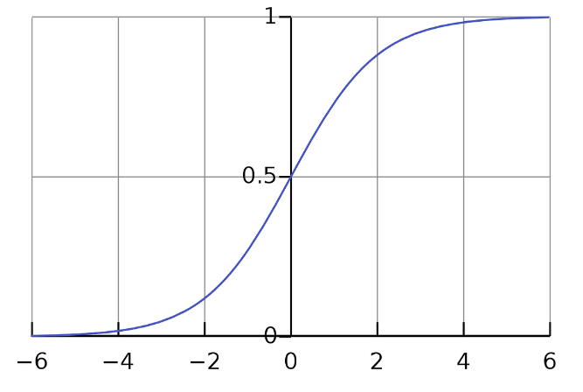
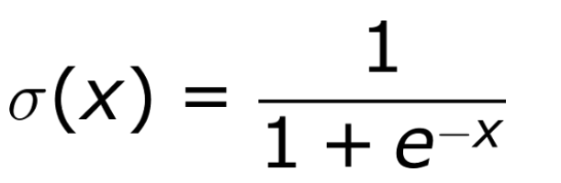
Sigmoid Function
The sigmoid “S curve”
With this the threshold value indicates the probability of winning or losing
squishes all its inputs (values on the x-axis) between 0 and 1
range of inputs for this function is the set of all Real Numbers and the range of outputs is between 0 and 1

Slide 11
Impact of sigmoid
Modifies both correctly classified as well as misclassified points
If the point is correctly classified, then it pushes the line away from itself
Misclassified – pulls the line towards itself
(Y_{i} – Y_hat) is not equal to 0

Slide 12
Example
Y_{i} | Y_hat | Y_{i} – Y_hat | W_{n}
1 | 0.8 | 0.2 | W_{n =} W₀ + ɳ(0.2)X_{i}
0 | 0.65 | -0.65 | W_{n =} W₀ - ɳ(0.65)X_{i}
1 | 0.3 | 0.7 | W_{n} = W₀ + ɳ(0.7)X_{i}
0 | 0.15 | -0.15 | W_{n} = W₀ - ɳ(0.15)X_{i}

Slide 13
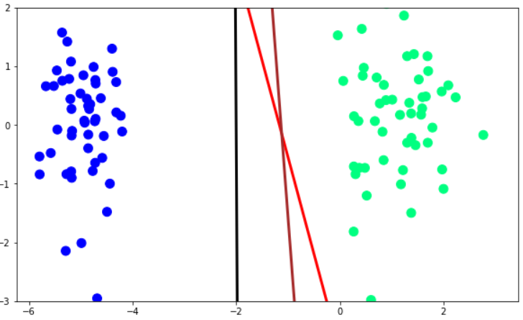
Comparison with the Logistic Regression

Slide 14
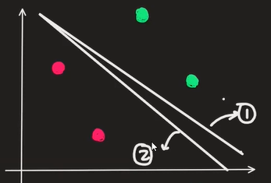
Maximum likelihood
The method of maximum likelihood selects the set of values of the model parameters that maximize the likelihood function
Used to derive the Loss Function
Y_hat(model 1) = 0.089
Y_hat(model 2) = 0.176
Model 2 is better

Slide 15
Binary Cross Entropy/Logs Loss
It is the negative average of the log of correctly predicted probabilities
Calculates the score that penalizes the probabilities based on the distance from the expected value
Choose the model ,whose Cross Entropy is minimum

Slide 16
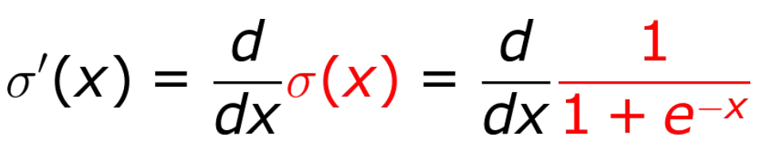
Derivative of the Sigmoid function
The equation of the sigmoid function:
Deriving the sigmoid function:

Slide 17
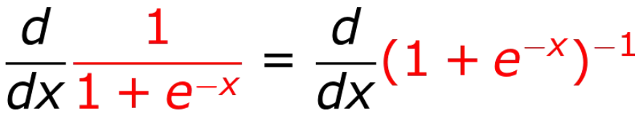
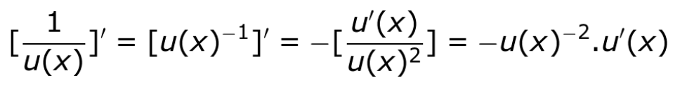
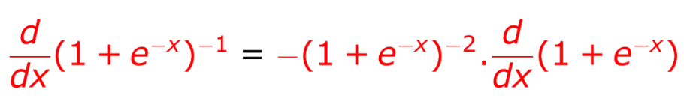
Expressing the above equation with negative exponents,
Applying the reciprocal rule, which simply says,
Applying the reciprocal rule,

Slide 18
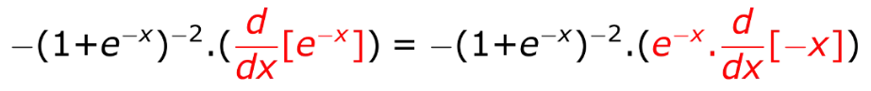
Applying the rule of linearity, we get
Applying the exponential rule we get,

Slide 19
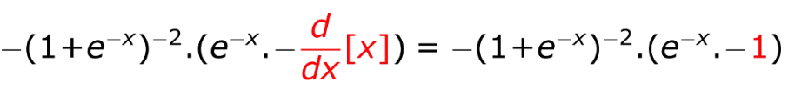
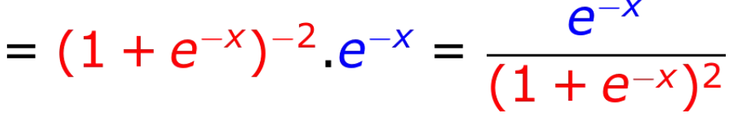
Next, by the rule of linearity we can write,
which can be written as,

Slide 20
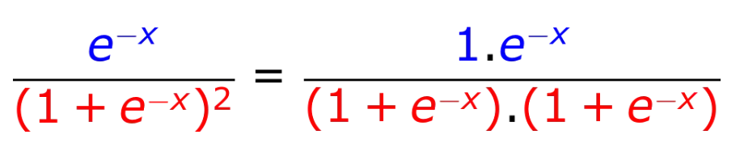
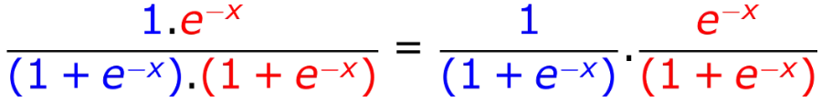
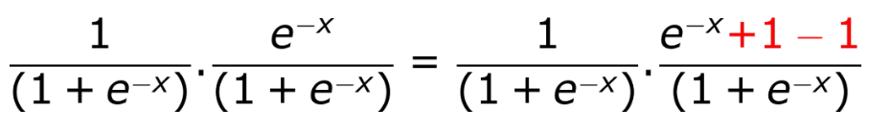
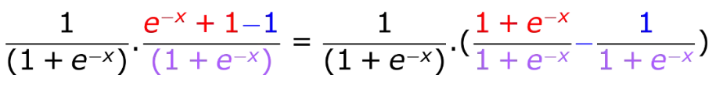

Slide 21
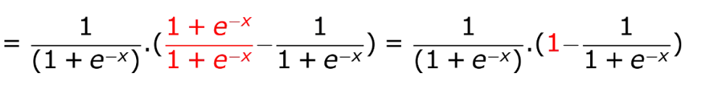
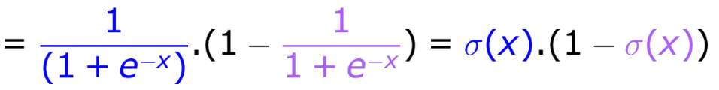
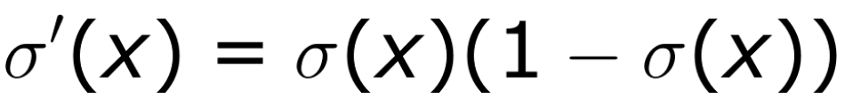
So, the derivative of the sigmoid function is

Slide 22
Loss Function
Loss function =∑($−y\log\left(\frac{1}{1+e^{−θTx}}\right)−(1−y)\log\left(1−\frac{1}{1+e^{−θTx}}\right)$)
Average Error = $\frac{1}{n} \sum_{i=1}^{n}{(−y^{\left(i\right)}\log\left(\frac{1}{1+e^{−θTx^{\left(i\right)}}}\right)−(1−y)\log\left(1−\frac{1}{1+e^{−θTx^{\left(i\right)}}}\right)\text{)} }$
This is called Log loss error or Binary Cross Entropy”

Slide 23

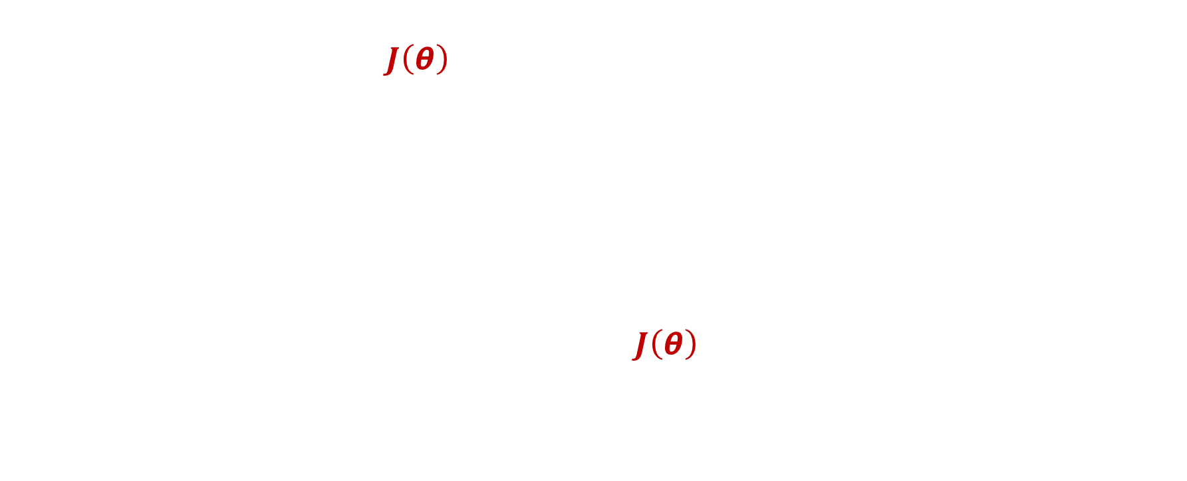

Gradient Decent For Logistic Regression
Have loss function $J\left(\text{θ}\right)$, where $\text{θ}\text{ = [}θ_{0}, …,θ_{m}]$
Start off with some guesses for $θ_{0}, …, θ_{m}$
It does not really matter what values you start off with, but a common choice is to set them all initially to zero
Repeat until convergence{
$$θ_{j}= θ_{j}−α \frac{∂J\left(\text{θ}\right)}{∂{ θ}_{j}}$$
}
Partial derivative
Note: Update all $θ_{j}$simulatenously
Learing rate, which controls how big a step we take when we update $θ_{j}$

Slide 24
Partial derivative of loss function w.r.t “w”
Loss function =∑($−y\log\left(\frac{1}{1+e^{−θTx}}\right)−(1−y)\log\left(1−\frac{1}{1+e^{−θTx}}\right)$)
1
2

Slide 25
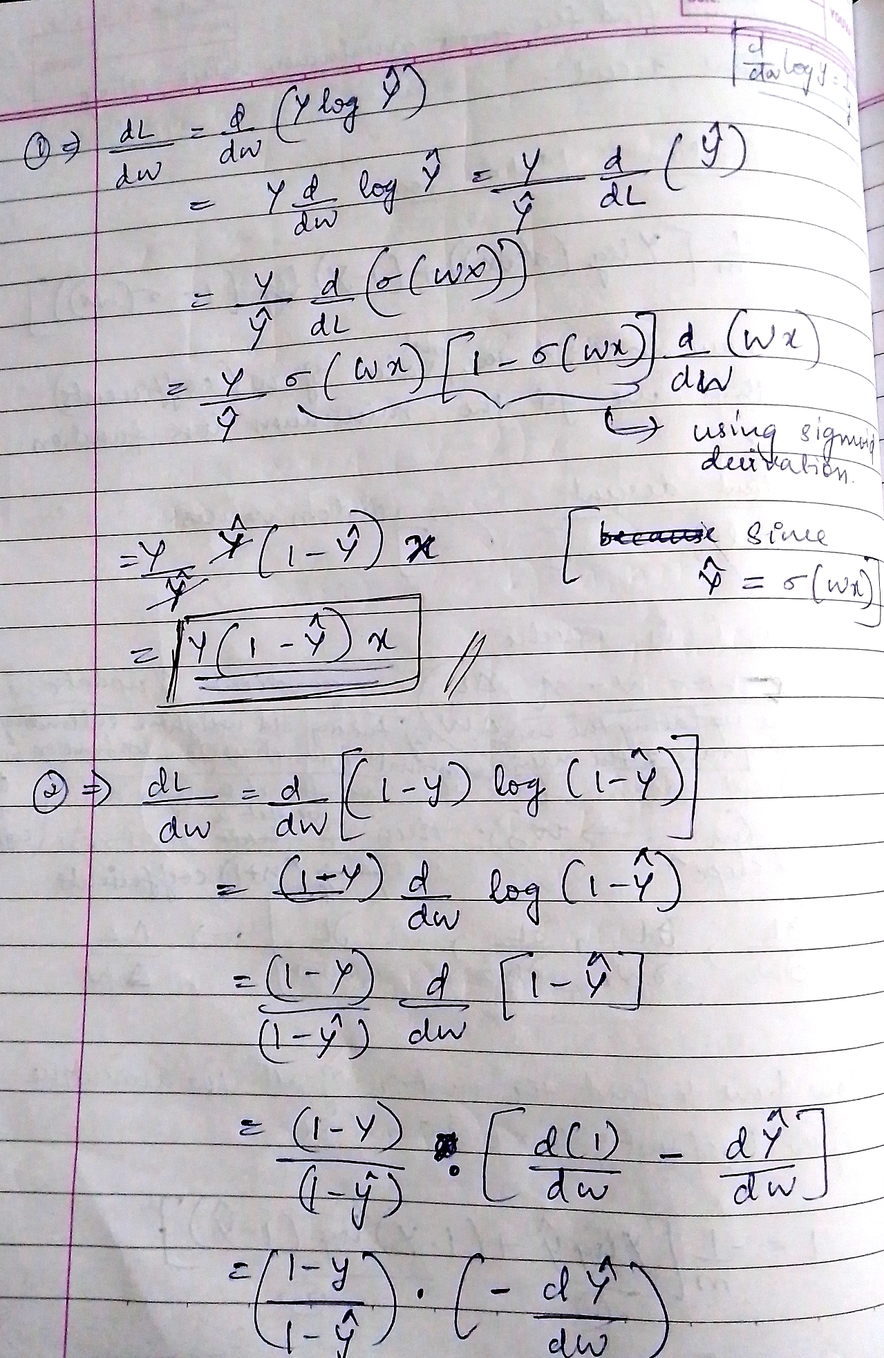

Slide 26
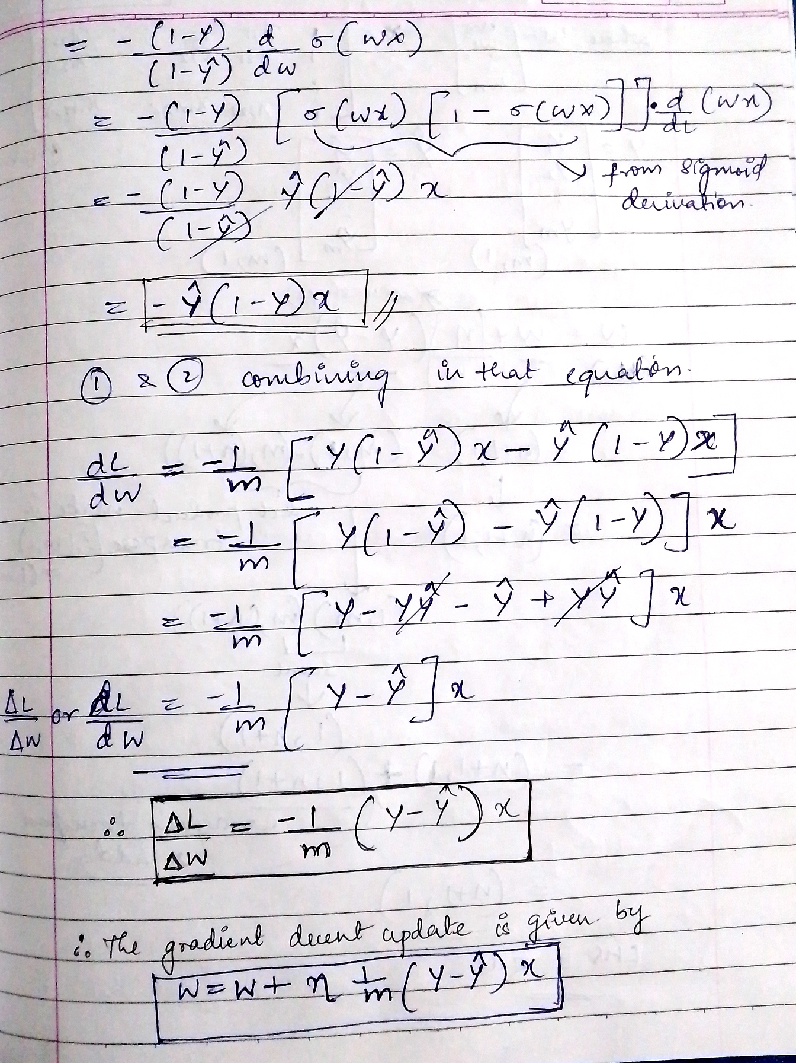
The final formula after applying partial derivatives:-
w = w + ɳ .(1/m).(y – y_hat) x

Slide 27
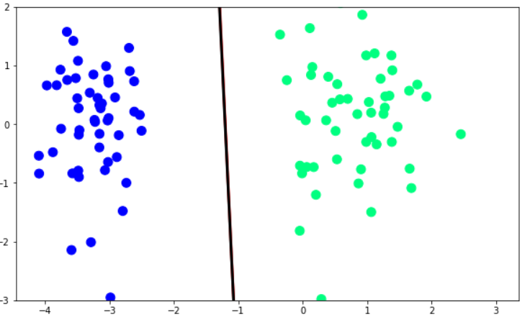
Comparison with the Logistic Regression

Slide 28
THANK YOU

